Slide 1
I Finished the Beginner Tutorial,
Now What?
Kelsey Karin Hawley
@kkarinhawley
These slides at https://github.com/khawley/my-talks

Slide 2

About Me
Software Engineer at Honor (joinhonor.com)
CS degree from UC Santa Cruz
Taught at Girls Who Code this summer
Currently a mentor at Hackbright
Avid reader and crafter
Notes:
Yes we're hiring!

Slide 3
This Talk
3 Types of Learning Approaches
Challenge Based Learning
Example Based Learning
Project based Learning
Community
Summary

Slide 4
Won't Cover

Slide 5

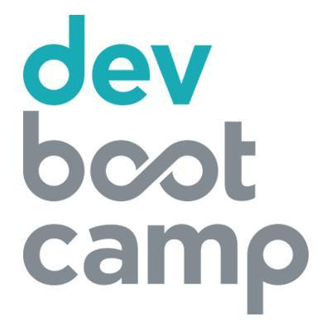



Won't Cover
Bootcamps, code schools
College or Online Courses
More tutorials

Slide 6
Challenge Based Learning
Notes:
-- 1:00

Slide 7
What Do I Mean?
Using multiple practice based exercises to grow your knowledge in small tangible ways
Appealing to those who:
Don't want a big project
Don't have small ideas to work on
Like Rewards + Trophies
Want thoroughly covered edge cases and learning tools
Challenge Based Learning
Notes:
-- 1:00

Slide 8
Tools
99 Problems
CodeChef
CodeCombat
CodeEval
CodeFights
CodeForces
CodeKata
CoderByte
CodeWars
CodinGame
DevDraft
Exercism.io
HackerRank
HackerEarth
LeetCode
Programmr
Project Euler
Rosalind
Spoj
Timus
TopCoder
Challenge Based Learning
Notes:
Lots of tools out there - just a quick google search, and definitely not all inclusive set

Slide 9
Choosing a Tool
Think about the features that matter to you:
Language agnostic
Strong solution testing
In-browser interpreter
Badges
Reviews
Competitions
Challenge Based Learning
Notes:
Language Agnostic - Will you be learning other languages down the road?
Solution Testing - really important for knowing when you're wrong or close but missing something
In-browser interpreter - if you travel a lot or don't have a dedicated computer this might be appealing
Badges or rewards if you are goal/award driven
Reviews - Feedback from your peers can help you grow
Competitions - good if you want to compete for prizes or need the motivation competition provides

Slide 10
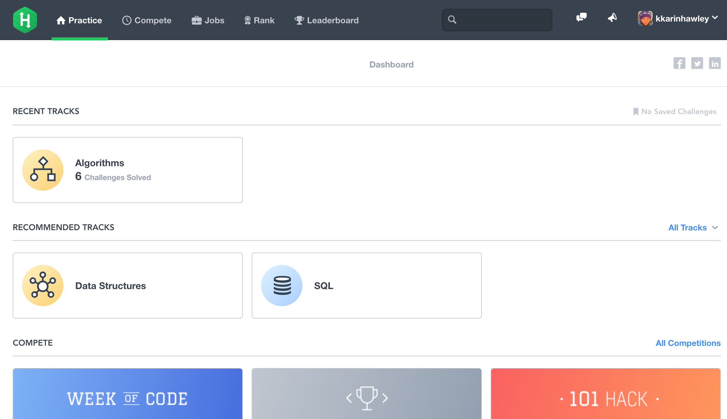
HackerRank
Challenge Based Learning
Notes:
-- 3:15

Slide 11
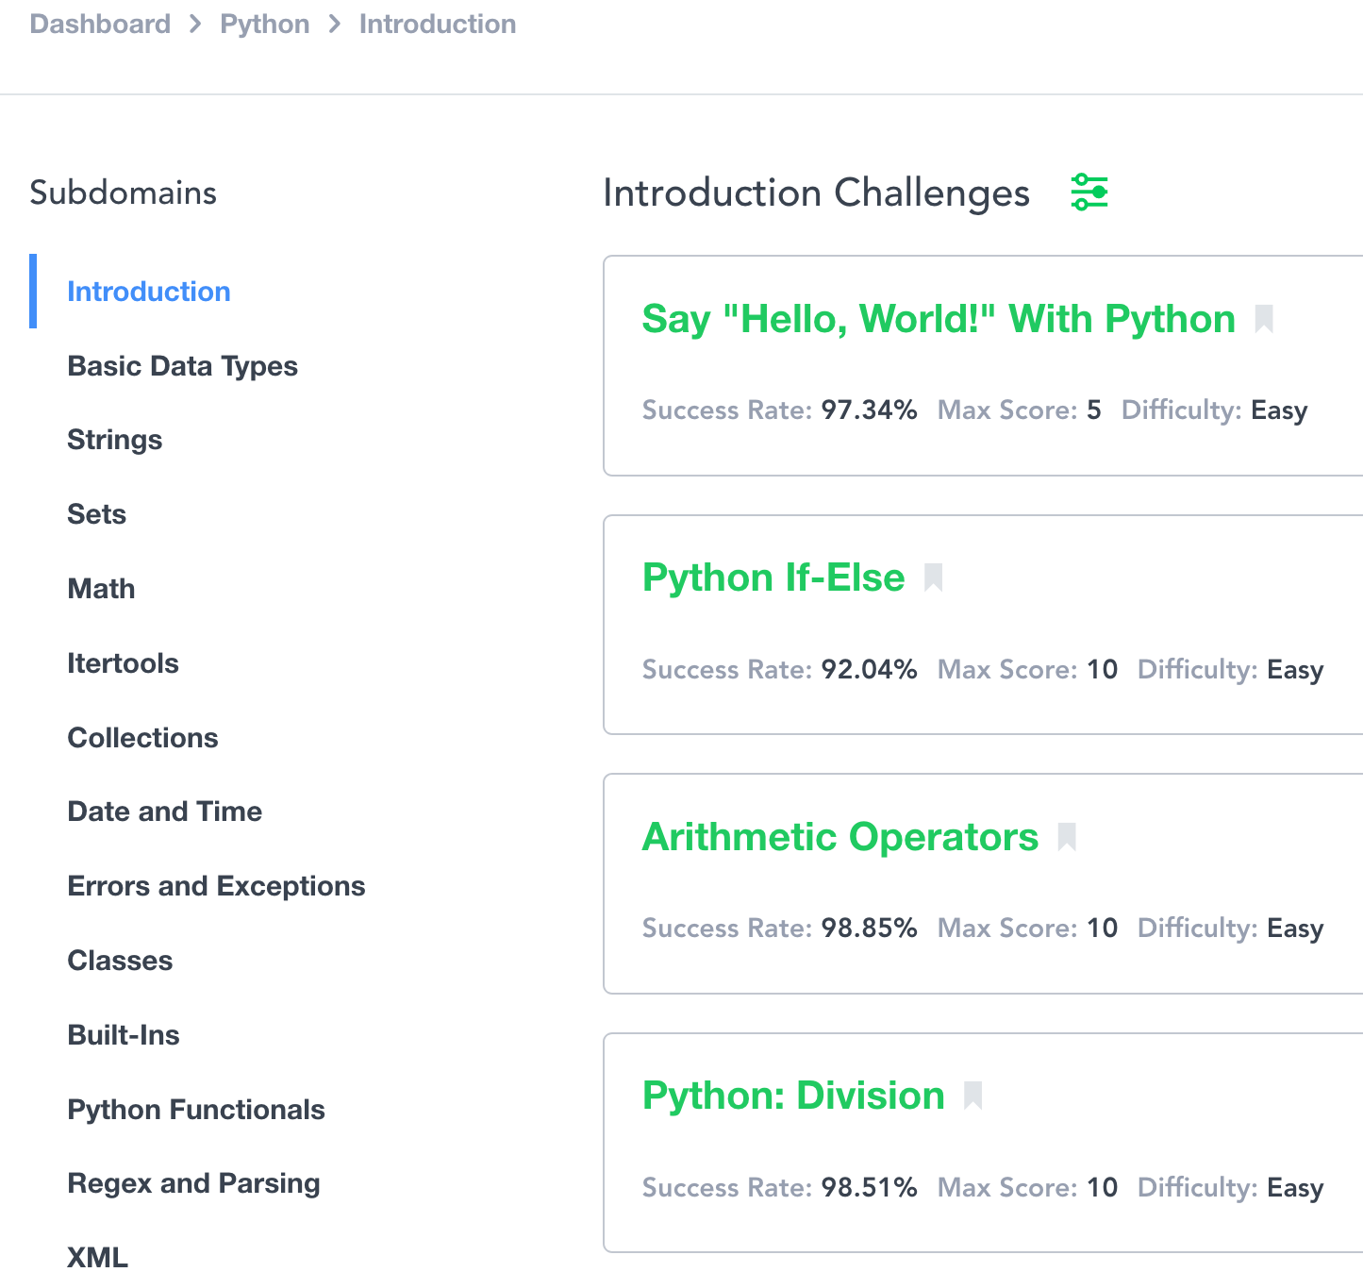
HackerRank - Pro's
Good diversity of problems + languages
Challenges start from easy and go to advanced
Challenge Based Learning
Notes:
-- 3:30
Python 2 + 3 compatible

Slide 12
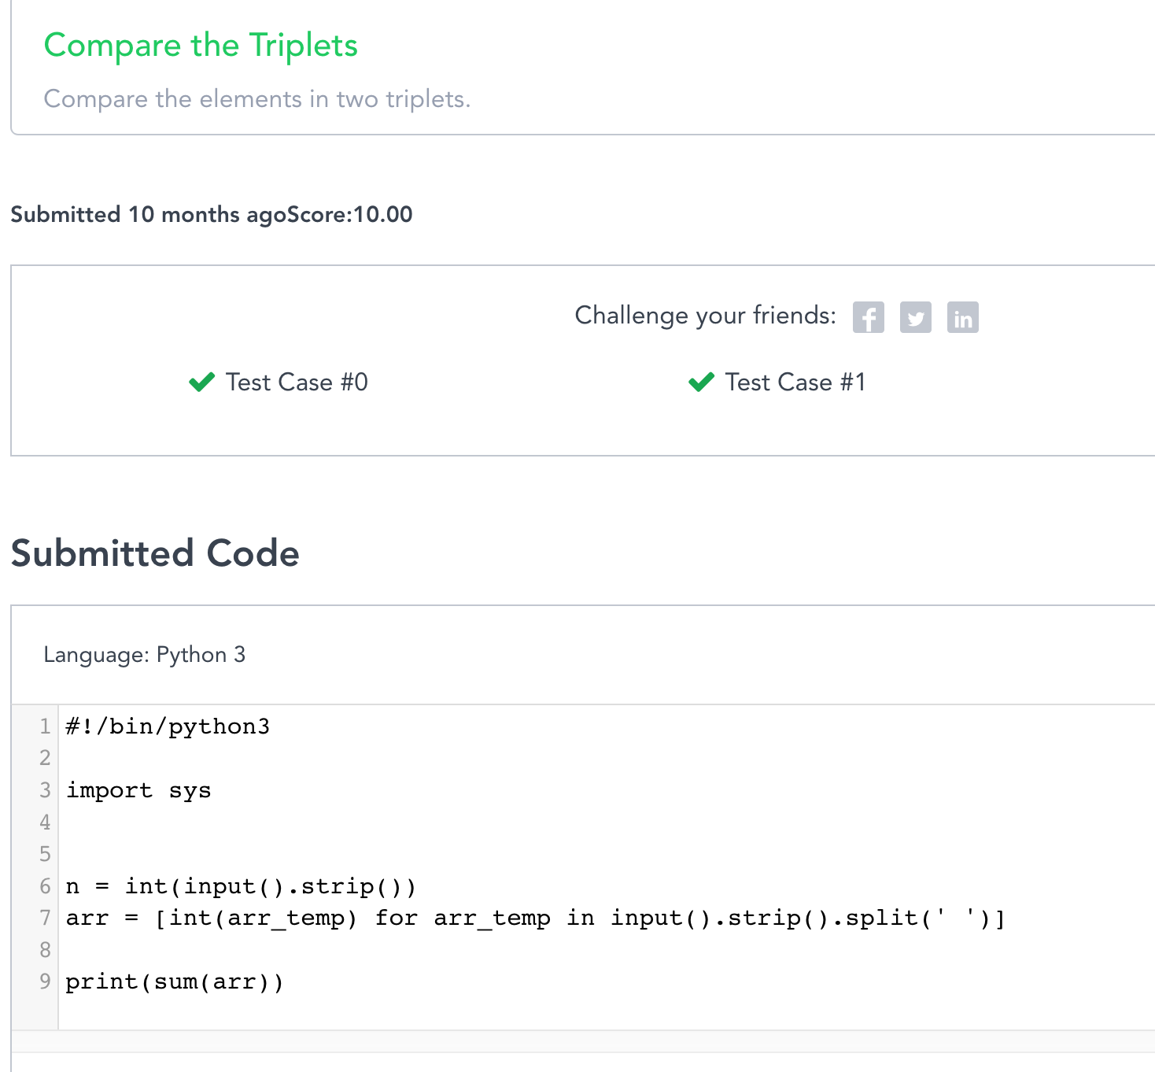
HackerRank - Pro's
Good in browser editor
Tests run in real-time
Error messages
Challenge Based Learning
Notes:
Error messages are shown for each failed test case - could be taking too long, could be missing an edge case, etc

Slide 13
HackerRank - Con's
No community feedback nor interaction
No way to work and test offline
Challenge Based Learning

Slide 14
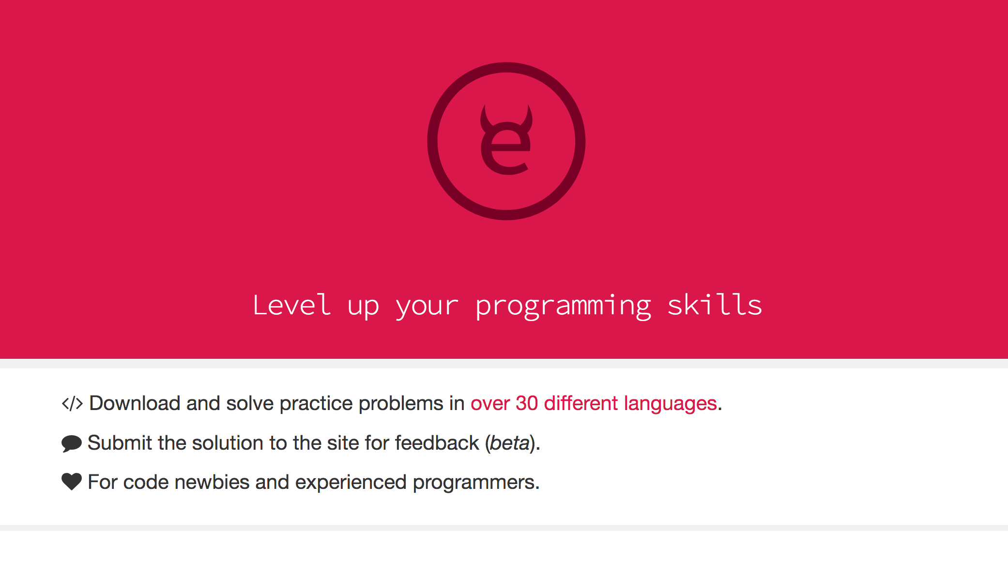
Exercism.io
Challenge Based Learning
Notes:
---5:30

Slide 15
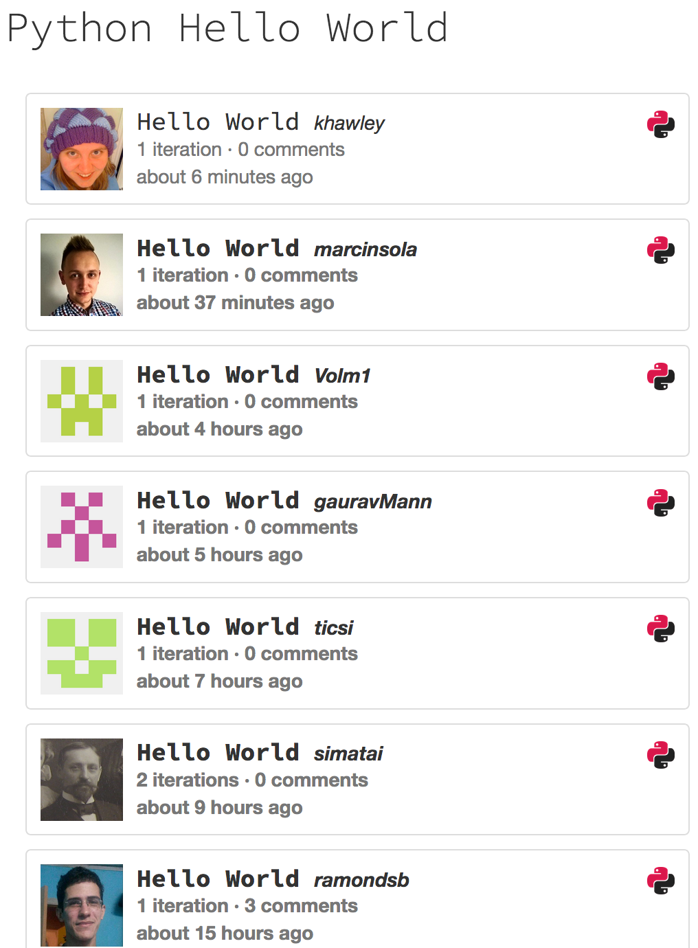
Exercism.io - Pro's
Able to review other users' code
Able to leave and receive comments on code
Can join a team
Community driven open source exercises
Challenge Based Learning
Notes:
--- 5:30
Supports python 2 + 3

Slide 16
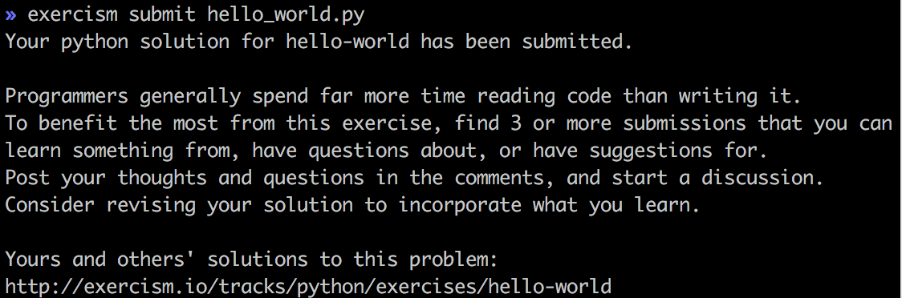
Exercism.io - Con's
Requires some knowledge of the command line
Relies on editor + terminal on your machine
Must complete an exercise to receive the next
Challenge Based Learning

Slide 17
More Tools
99 Problems
CodeChef
CodeCombat
CodeEval
CodeFights
CodeForces
CodeKata
CoderByte
CodeWars
CodinGame
DevDraft
HackerEarth
LeetCode
Programmr
Project Euler
Rosalind
Spoj
Timus
TopCoder
Challenge Based Learning
Notes:
--6:45
Lots more out there to explore
Find one that works for you
Look for one that is active and updated

Slide 18
Summary
Great way to build incrementally on a new language
Built-in tests tell you when you're missing something
Built-in community can cheer you on and offer guidance
May include a job board or competitions for prizes
Challenge Based Learning
Notes:
Just be sure to pick one that appeals to you

Slide 19
Example Based Learning
Notes:
-- 7:00

Slide 20
What Do I Mean?
Reading through someone else's code to gain knowledge or using someone else's code as a starting point
Appealing to those who:
Need a starting point
Want to see how others write code
Want to see abstract concepts in use
Don't want to write code from scratch
Like reading and reviewing other's work to grow skills
Example Based Learning
Notes:
-- 7:00

Slide 21
Finding a project
Need some comfort with GitHub and Git
What to look for:
Readme/setup instructions
Under active development
Contributor is responsive
The code easy to read and follow along with
Able to google for foreign terms being used
Example Based Learning
Notes:
First you'll need a basic understanding of using git and github, as this will involve finding projects through github and likely cloning them. If you don't feel comfortable navigating and cloning projects yet, I'll have a link to a few tutorials at the end

Slide 22
Finding a project
What to avoid:
It uses a lot of outside packages that you don't understand
Its overly complex
You're having trouble building or running based on the Readme instructions
Its not clear where you would even start reading the code
Example Based Learning
Notes:
It uses a lot of outside packages that you don't understand
Overly complex - opening 5+ files to follow the logic

Slide 23
Finding a project
Tips for searching:
Lots of open repositories to explore on GitHub
What tools do you use? Do they have anything on GitHub that you could explore?
Friends or engineers you admire on GitHub? Explore their repos
Find one that is interesting to you, as you'll be spending lots of time reading and working with it
Example Based Learning

Slide 24
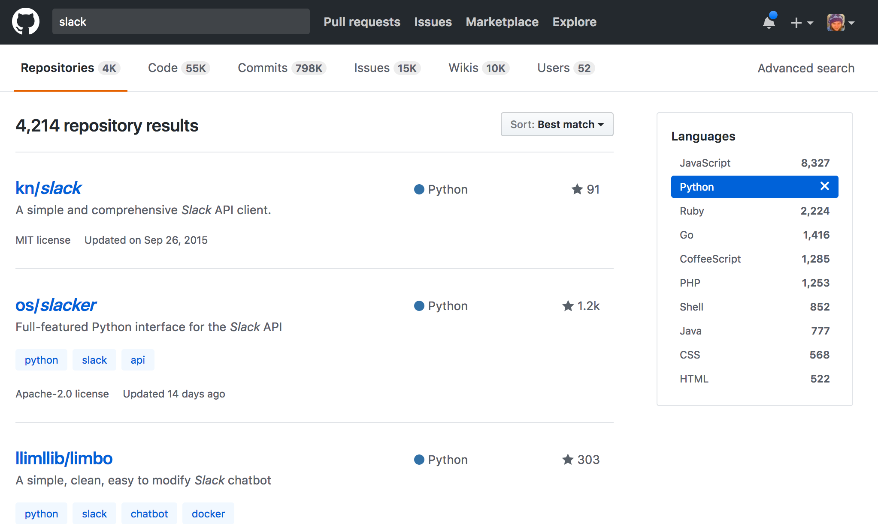
Finding a project
Example Based Learning
Notes:
Oh look a slack bot

Slide 25
Reading Code
Reading through someone's code will take some time
What their code is trying to do
What does it require to get there
What are the lines of code actually doing
Example Based Learning
Notes:
Macro - Understand what their code is trying to do:
Is it a bot? Is it a command line tool? Is it a webapp?
Understand what they require to get there:
What are they importing? What did they install from 3rd party packages?
Micro - Understand what that code is actually doing:
What is this function specifically doing? What functions is it using from somewhere else?

Slide 26
Dig In
Why did they write it this way? Could it be written it differently?
What happens if you change a variable value?
What happens if you change part of a function?
Example Based Learning
Notes:
Once you've got a basic understanding and have it running on your machine, try messing with it.

Slide 27
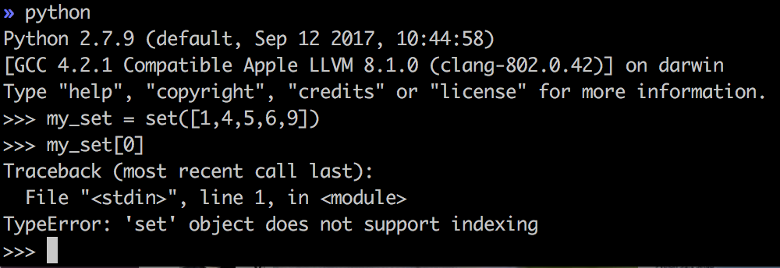
Dig In
Use error messages to your advantage
Example Based Learning
Notes:
You might find the developer left custom error messages. Or you might get lengthy python stack traces to play with.
Remember: You aren't breaking their code by experimenting. You are safe to frollick and cavort creating chaos and errors. Use this as an opportunity to learn!

Slide 28
Dig In - Next Steps
Are there open bugs that you could fix?
Can you add a new feature?
Example Based Learning

Slide 29
Take-aways
New 3rd party packages?
Exposure to a builtin you hadn't used before?
New concepts you hadn't seen?
Example Based Learning
Notes:
Python package - requests
Builtins - like sets or filtering lists, d
Concepts - decorators, generators

Slide 30
Summary
Find a repository that you can follow along with
Ask questions of the code
Don't be afraid to tinker
Use what you learned
Example Based Learning

Slide 31
Project Based Learning
Notes:
-- 14:30

Slide 32
What Do I Mean?
Building your own project from scratch
Appealing to those who:
Already have a project in mind
Can't find a good example project on GitHub
Are self-motivated and goal oriented
Creating a portfolio
Project Based Learning
Notes:
-- 14:30
Some people learn best by diving into their own projects
Like creating goals, expectations, or doing project planning

Slide 33
Project Management
Beware of Scope Creep
Project Based Learning
Notes:
My biggest piece of advice

Slide 34
Project Management
Map out all the project to-do's and break them down
Focus on small, manageable pieces
Break things out further if you're getting discouraged
Celebrate each success
Project Based Learning
Notes:
To-do's can include anything: research, experimentation, coding, documentation, setup, tests
Transition: When you find yourself getting stuck...

Slide 35
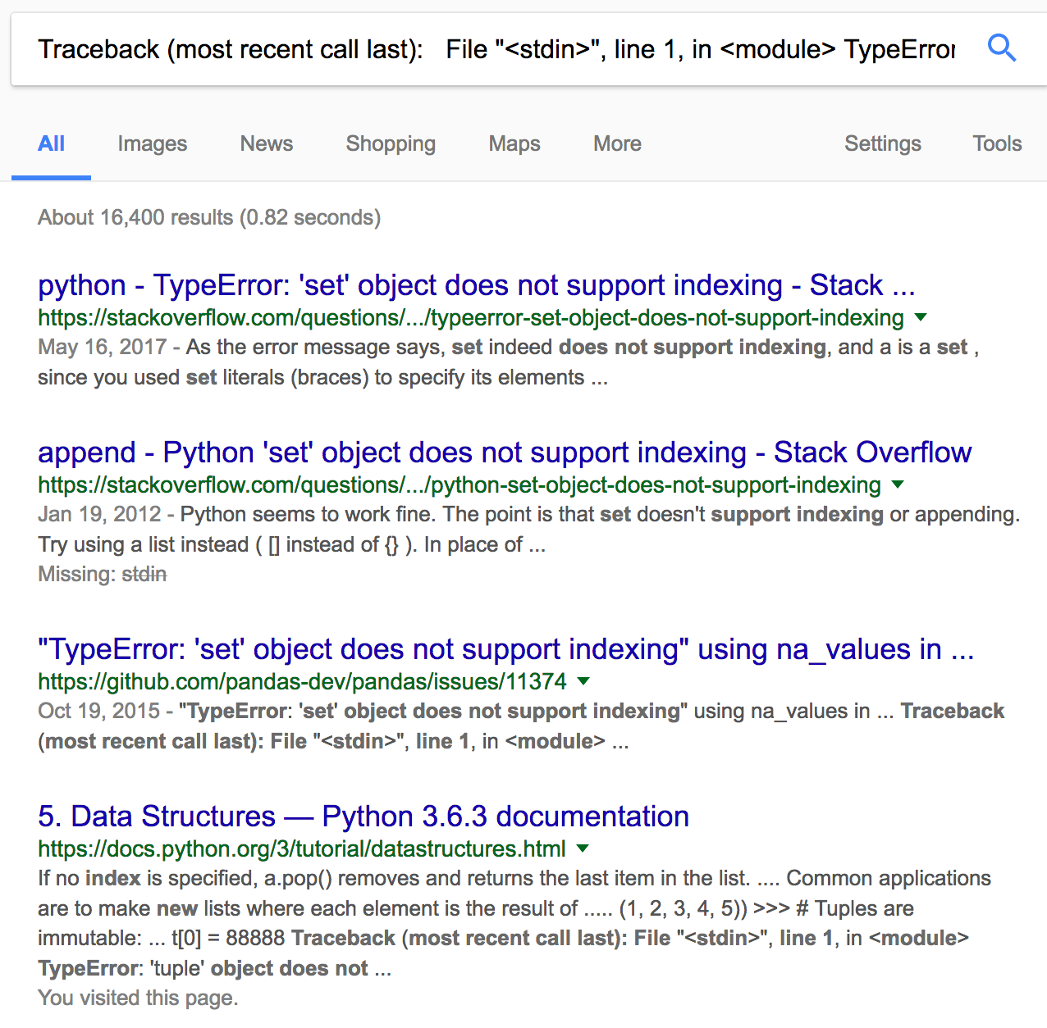
Google is your friend
Utilize StackOverflow
Copy & Paste error messages right into search
Project Based Learning
Notes:
StackOverflow for questions, for errors, for "how do I ___ ?"

Slide 36
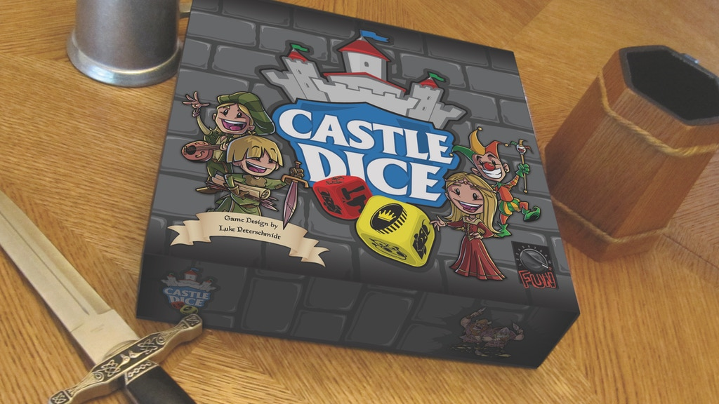
My Passion Project
Project Based Learning
Notes:
-- 17:30

Slide 37
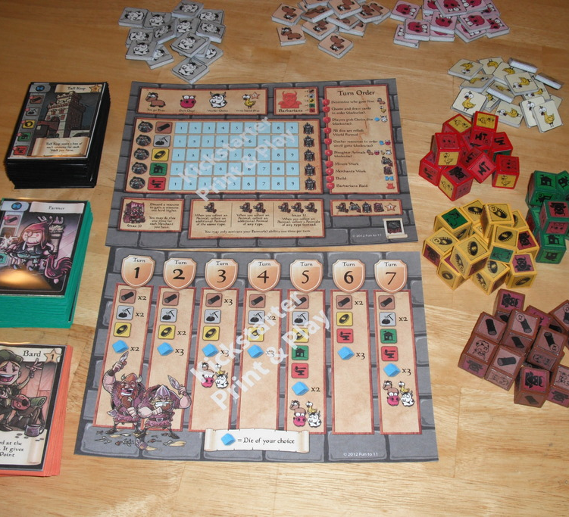
Castle Dice
Castle Dice has a lot of components
Each component had multiple interactions with its surrounding components
There were pieces to track pieces to track pieces...
Complexity was high
Project Based Learning
Notes:
-- 17:30

Slide 38
Castle Dice
Breaking it down:
5 types of dice
Each die had unique sides. How could I store & access them?
How could I 'roll' a die to get a random result?
Sometimes dice are added together. How could I keep that information?
2 unique decks
...
Project Based Learning
Notes:
I broke down each component into even smaller pieces
First I built a die roller. How would that even work?
Then I determined how I could store the 'sides' and change my die roller to roll these unique sides.
Etc

Slide 39
Castle Dice
So, is it done?
Project Based Learning

Slide 40
Castle Dice
So, is it done?
No. But I tinker on it every few months and make small improvements as time allows.
Project Based Learning

Slide 41
Castle Dice
My takeaways:
This was a really big project.
I should have chosen something smaller
There were a lot of unknowns I didn't consider.
There are a lot of knowns I still don't know how to approach
I learned a lot
I had fun
It doesn't matter whether I 'completed' it
Project Based Learning
Notes:
My lessons -

Slide 42
Summary
Try to choose a small, manageable project
Break it into even smaller tasks
Ask for help when you need it
StackOverflow and Google are your friends
Everything is "work-in-progress"
Have fun
Project Based Learning
Notes:
I still consider Castle Dice a work-in-progress, not an abandoned project

Slide 43
Community
Notes:
-- 20:30

Slide 44
Why Community Matters
Community groups are actively developing in their language and tools.
Members can offer advice or resources
Community
Notes:
The previous styles won't teach you to code, only give you ways to practice.
Members can help you with your projects, connect you with other beginners, provide you with even more resources.

Slide 45
Mentors
Both help and encourage learners.
Have tips for overcoming tricky concepts.
Teach you how to think about a problem, without just giving you the answer.
Care about your growth
Community
Notes:
One of the most valuable things you can get from interacting with coding communities are mentors.
Mentors - super valuable
help + encourage
Were beginners once + can sympathize with pains/pitfalls of a language. They can also share tips/tricks they've learned
Good mentor will coach you to the solution, not just give you the answer
Will want to share in your successes

Slide 46
Python specific
PyLadies
SF Python Meetup
SF Django Meetup
PyCon
NorthBayPython
PyBay
Community
Notes:
Mix of conferences & groups that focus on Python.

Slide 47
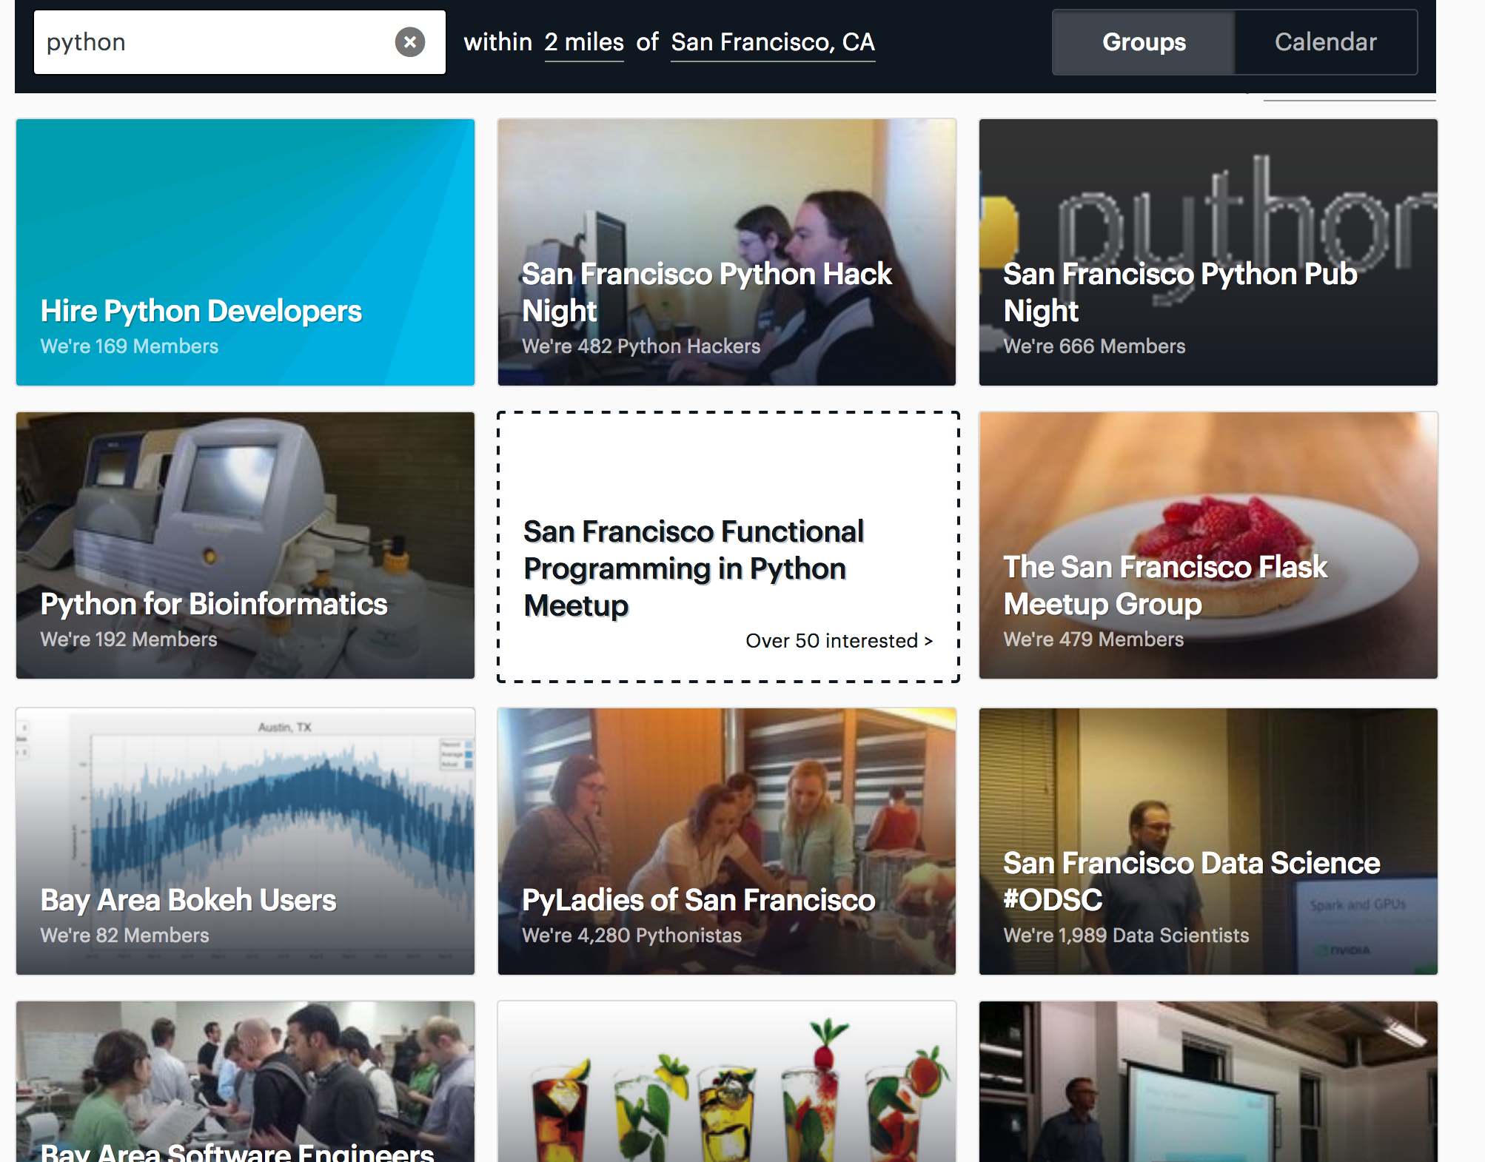
Meetup.com
Community
Notes:
Even more by searching your city + Python online

Slide 48



Other languages
Waffle.js
RailsBridge
HackerSpace
Community
Notes:
Also Donut.js in Portland

Slide 49




For the Gals
PyLadies
Girl Geek Dinners
Women Who Code
Girl Develop It
Community

Slide 50
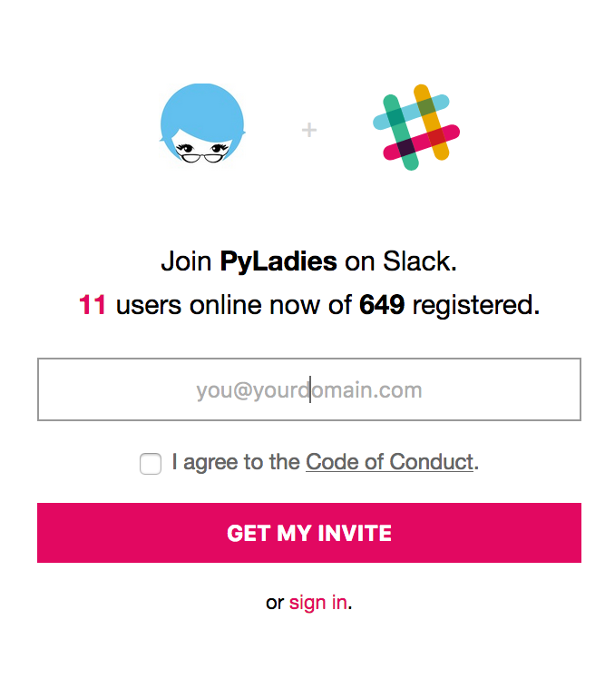
Online
Many groups have chat equivalents online too
Exercism.io & others have built-in communities
Coding communities
Community
Notes:
CodeBuddies new to me, but seems to be a way to connect online with fellow coders/learners

Slide 51
Summary
Notes:
-- 23:30

Slide 52
Summary
Challenge Based
Example Based
Project Based
Community
There's no one way to continue learning and growing
Notes:
Challenge based:
Practicing with small exercises
Test cases, Community feedback
Example based:
Find a repository that is interesting
Ask questions of the code
Try and break it, then fix it
Project based:
Break down any project idea into small pieces
Have fun
Community - Lots of ways to connect
Groups, Tech Events Conferences
Mentor

Slide 53
Resources
Me - @kkarinhawley, Honor (joinhonor.com)
These slides at https://github.com/khawley/my-talks
Challenge based
HackerRank.com
Exercism.io
Example based
Git/GitHub Tutorials
My Gitbook - https://www.gitbook.com/book/khawley/git-github-basics-tutorial/details
Atlassian's tutorial - http://www.atlassian.com/git/tutorials/what-is-version-control
Project based
CastleDice, the never ending - https://github.com/khawley/CastleDice

